Slide 1
Resolving Sparsity in Recommendation Systems using SGD
191FA04547: – V Sasidhar Reddy
191FA04551: – V Vishnu Vinayak
Name of the Guide : Ch Pushya
Designation: Assistant Professor

Slide 2
Introduction
Recommendation systems are algorithms and techniques used to provide personalized suggestions or recommendations to users.
These systems are widely used in various domains, including e-commerce, streaming platforms, social media, and content platforms.
There are primarily two types of recommendation systems: collaborative filtering and content-based filtering.
While recommendation systems are valuable tools, they can encounter several challenges. Such as Cold Start Problem, Scalability, Diversity vs. Accuracy Trade-off, Popularity Bias, Limited Context and Data Sparsity.

Slide 3
Introduction
Sparsity is a common challenge in machine learning where the data exhibits a high degree of emptiness or contains a large number of zero values.
Dealing with sparse data presents unique issues for machine learning algorithms, as it can lead to computational inefficiencies, biased predictions, and suboptimal model performance.
Resolving sparsity is crucial for extracting meaningful information and improving the accuracy and efficiency of machine learning models.
For resolving sparsity we can make use of matrix factorization techniques.

Slide 4
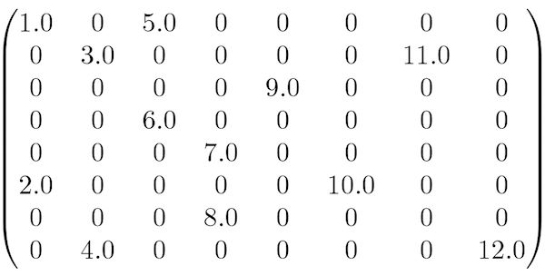
Sparse Matrix

Slide 5
Issues due to Sparsity
Data Insufficiency
Cold Start Problem
Limited User Coverage
Inaccurate Similarity Measures
Popularity Bias

Slide 6
Literature Survey
We have conducted a literature survey to study the different techniques involved in avoiding sparsity problem on Netflix dataset.
S.No | Title of Paper | Author | Year | Technique
01 | Matrix factorization techniques for recommender systems. [1] | Koren Y | 2009 | Singular Value Decomposition(SVD)
02 | BPR: Bayesian personalized ranking from implicit feedback. [2] | Rendle, Freudenthaler, Gantner, & Schmidt-Thieme | 2009 | Weighted Regularized Matrix Factorization
03 | Improving regularized singular value decomposition for collaborative filtering. [3] | Paterek | 2007 | Singular Value Decomposition(SVD)
04 | Factorization Meets the Neighbourhood: A Multifaceted Collaborative Filtering Model.[4] | Yehuda Koren | 2013 | Multifaceted collaborative filtering and SGD
05 | A Hybrid Collaborative Filtering Algorithm Based on Singular Value Decomposition and Stochastic Gradient Descent.[5] | Li et al | 2016 | Singular value decomposition with SGD

Slide 7
Literature Survey
S.No | Title of the Paper | Author | Year | Technique
06 | Large-scale parallel collaborative filtering for the Netflix prize.[8] | Large-scale parallel collaborative filtering for the Netflix prize | 2008 | Singular Value Decomposition(SVD)
07 | SoRec: social recommendation using probabilistic matrix factorization.[9] | Ma, Hao; Yang, Haixuan; Lyu, Michael R.; King, Irwin | 2008 | Maximum Margin Matrix Factorization (MMMF)
08 | One-Class Collaborative Filtering.[12] | Rong Pan, Yunhong Zhou, Bin Cao, Nathan N. Liu, Rajan Lukose | 2008 | Singular Value Decomposition(SVD)
09 | A Contextual-Bandit Approach to Personalized News Article Recommendation[7] | Li, Lihong; Chu, Wei; Langford, John; Schapire, Robert E | 2010 | LinUCB with Disjoint Linear Models
10 | Collaborative filtering beyond the user-item matrix: A survey of the state of the art and future challenges. | Shi, Yue; Larson, Martha; Hanjalic, Alan | 2014 | Collabirative Filtering

Slide 8
Background – Why Problem Statement?
Most of the literature discussed the usage of matrix factorization to avoid the Sparsity.
Matrix factorization is a commonly used technique in recommendation systems because it allows the system to model user-item interactions in a compact and efficient way.
For this use case based on our survey we are using Stochastic Gradient Descent(SGD) MF technique to make the sparse user-item interaction matrix dense.

Slide 9
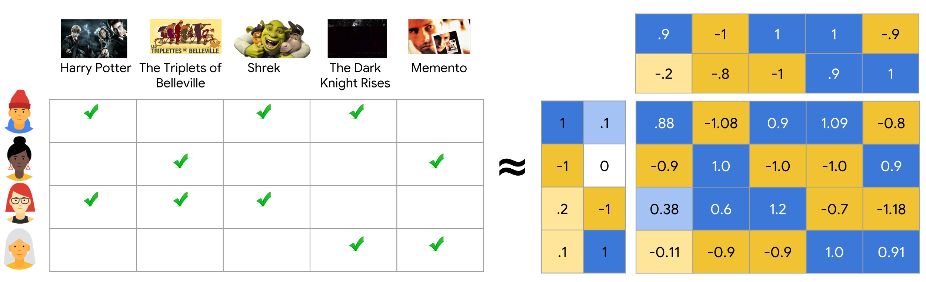
Singular Value Decomposition

Slide 10
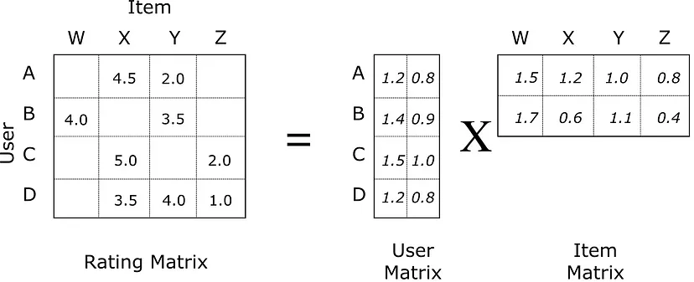
Matrix Factorization

Slide 11
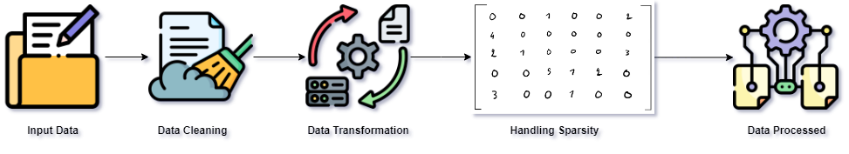
Architecture

Slide 12
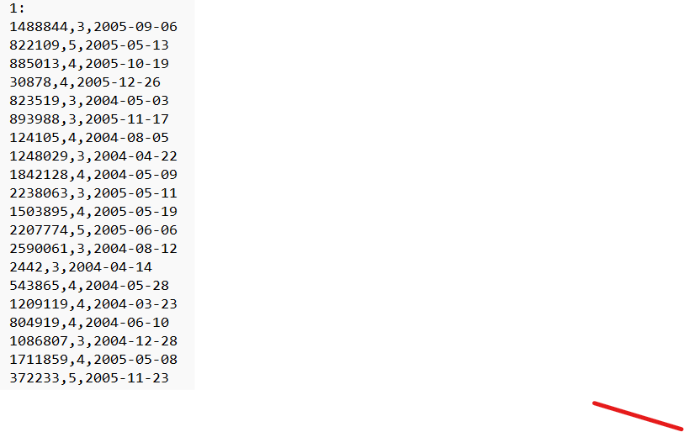
Data Set
Netflix shared a subset of the Netflix Prize dataset on the Kaggle platform for participants to download and use for training and validation purposes. This allowed participants to develop their recommendation algorithms using the provided dataset.[6]
1 | 2003 | Dinosaur Planet
2 | 2004 | Isle of Man TT 2004 Review
3 | 1997 | Character
4 | 1994 | Paula Abdul's Get Up & Dance
5 | 2004 | The Rise and Fall of ECW
6 | 1997 | Sick
7 | 1992 | 8 Man
8 | 2004 | What the #$*! Do We Know!?
9 | 1991 | Class of Nuke 'Em High 2
10 | 2001 | Fighter

Slide 13
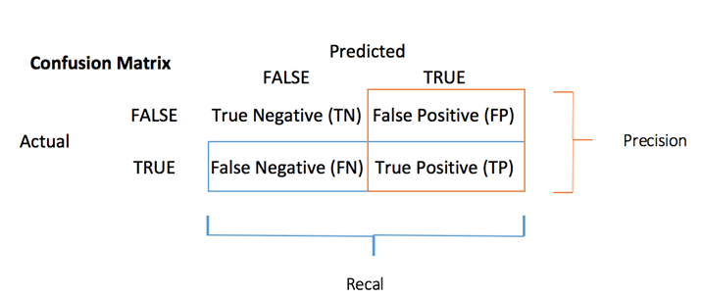
Evaluation of the Model

Slide 14

Evaluation Metrics
$Accuracy=\frac{TP+TN}{TP+TN+FP+FN}$
$R M S E=\sqrt{\frac{1}{N} \sum_{i=1}^{N}{{\left(y_{i}−\hat{y_{i}}\right)}^{2}}}$
$MSE=\frac{1}{N}\sum_{i=1}^{N}{{\left(y_{i}−\hat{y_{i}}\right)}^{2}}$
$Precision=\frac{TP}{TP+FP}$
$F1−Score=\frac{2∗Precision∗Recall}{Precision+Recall}$

Slide 15
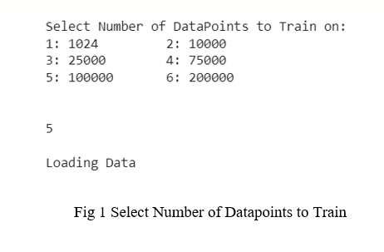
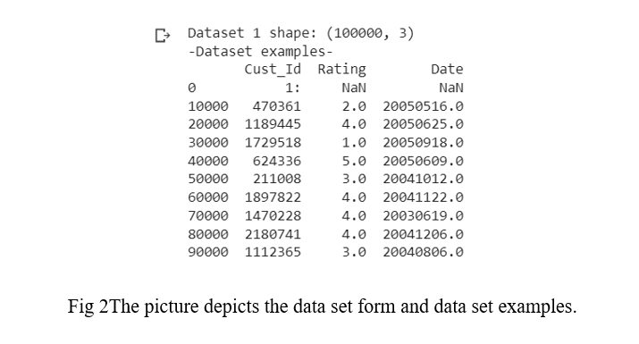
Results

Slide 16
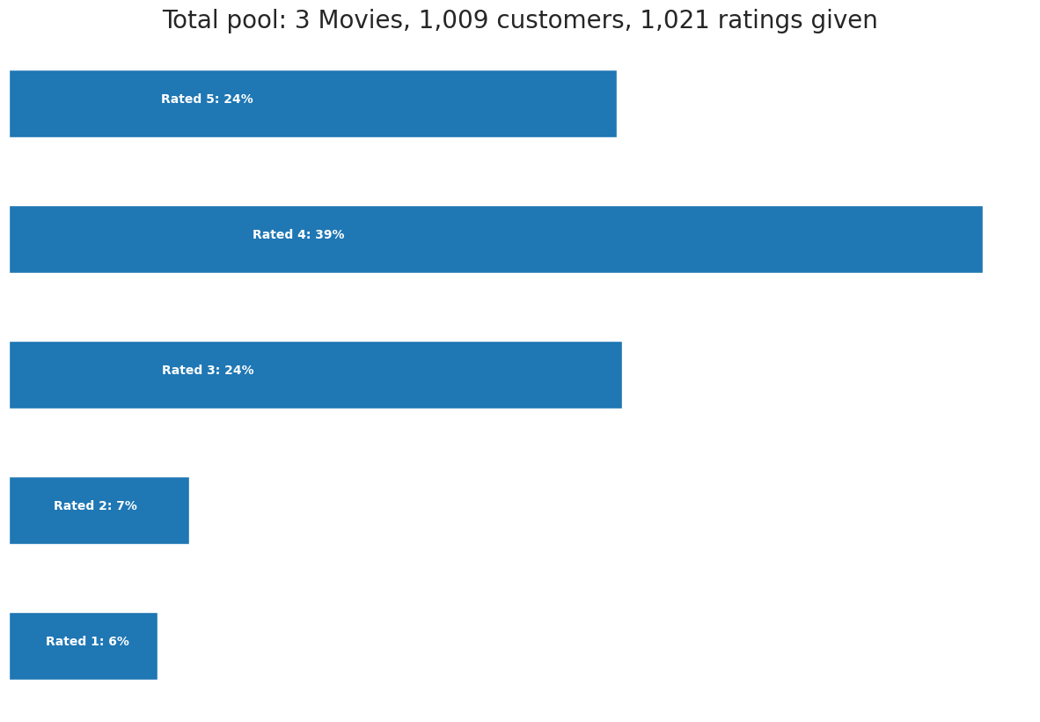
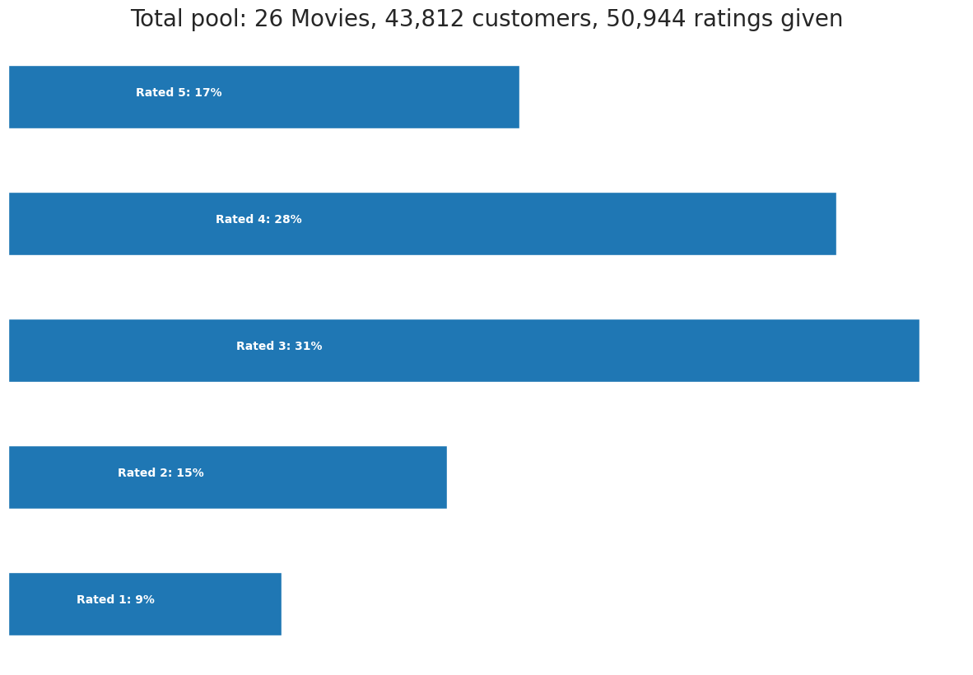
Showing the distribution of ratings given by the users in different pools.

Slide 17
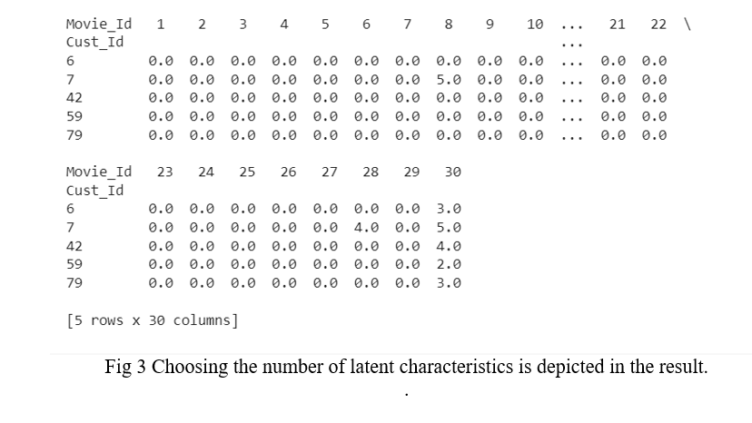

Slide 18
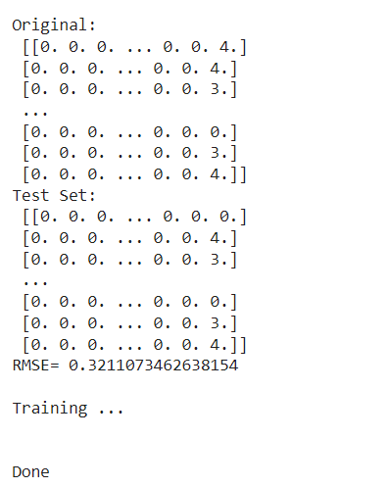
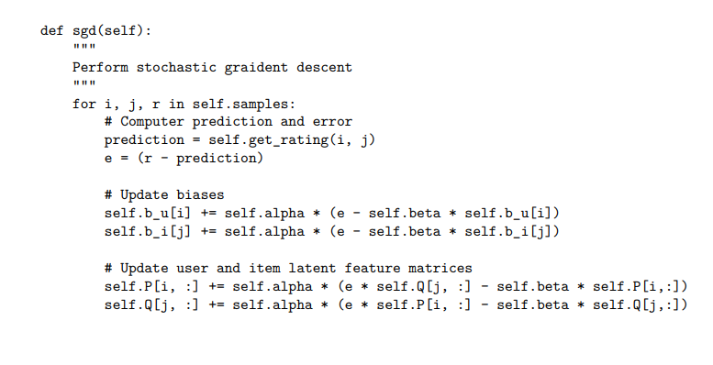
Stochastic Gradient Descent
Algorithm

Slide 19
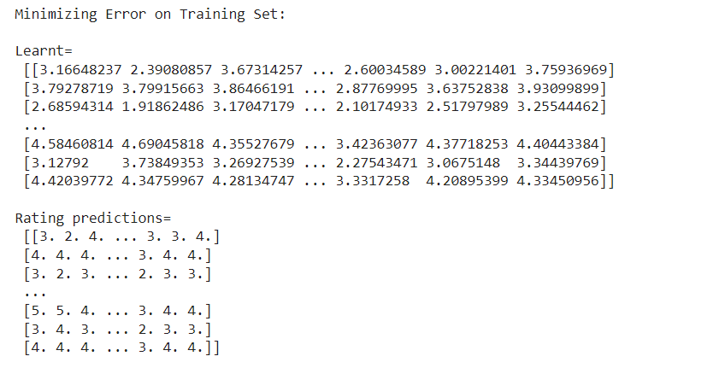
Predicting Ratings

Slide 20
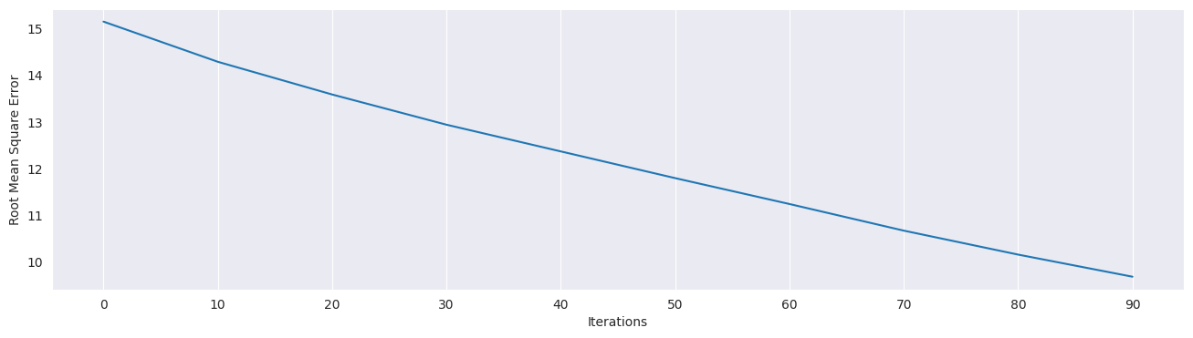
RMSE
RMSE final= 0.0006498375474807662

Slide 21
Conclusion
SGD is efficient, scalable, and adaptable to handle sparsity in user-item interaction data. It can effectively learn from incomplete or missing data points, making it suitable for recommendation systems.
Overall, by employing an effective methodology that includes data pre-processing, feature selection, partitioning, model building, and evaluation, it is possible to develop recommendation systems that can address the sparsity challenge and generate accurate and relevant recommendations for users.

Slide 22
References
[1] Koren, Y., Bell, R., & Volinsky, C. (2009). Matrix factorization techniques for recommender systems. Computer, 42(8), 30-37.
[2] Rendle, S., Freudenthaler, C., Gantner, Z., & Schmidt-Thieme, L. (2009). BPR: Bayesian personalized ranking from implicit feedback. In Proceedings of the Twenty-Fifth Conference on Uncertainty in Artificial Intelligence (UAI) (pp. 452-461).
[3] Arkadiusz Paterek (2007). Improving regularized singular value decomposition for collaborative filtering . KDDCup.07 August 12, 2007, San Jose, California, USA Copyright 2007 ACM 978-1- 59593-834-3/07/0008 ...$5.00.
[4] Yehuda Koren(2007). Factorization Meets the Neighbourhood: A Multifaceted Collaborative Filtering Model.
[5] Li et al (2016) A Hybrid Collaborative Filtering Algorithm Based on Singular Value Decomposition and Stochastic Gradient Descent.
[6] https://www.kaggle.com/datasets/netflix-inc/netflix-prize-data
[7] Li, L., Chu, W., Langford, J., & Schapire, R. E. (2010). A contextual-bandit approach to personalized news article recommendation. In Proceedings of the 19th international conference on World Wide Web (pp. 661-670).

Slide 23
References
[8] Zhou, Y., Wilkinson, D., Schreiber, R., & Pan, R. (2008). Large-scale parallel collaborative filtering for the Netflix prize. In International Conference on Algorithmic Applications in Management (pp. 337-348).
[9] Ma, H., Yang, H., Lyu, M. R., & King, I. (2008). Sorec: Social recommendation using probabilistic matrix factorization. In Proceedings of the 17th ACM conference on Information and knowledge management (pp. 931-940).
[10] Shi, Y., & Larson, M. (2014). Collaborative filtering beyond the user-item matrix: A survey of the state of the art and future challenges. ACM Computing Surveys (CSUR), 47(1), 3.
[11] Singh, A. P., & Gordon, G. J. (2008). Relational learning via collective matrix factorization. In Proceedings of the 14th ACM SIGKDD international conference on Knowledge discovery and data mining (pp. 650-658).
[12] Pan, R., Zhou, Y., Cao, B., Liu, N. N., Lukose, R., Scholz, M., & Yang, Q. (2008). One-class collaborative filtering. In Proceedings of the 2008 Eighth IEEE International Conference on Data Mining (pp. 502-511).

